Slide 1
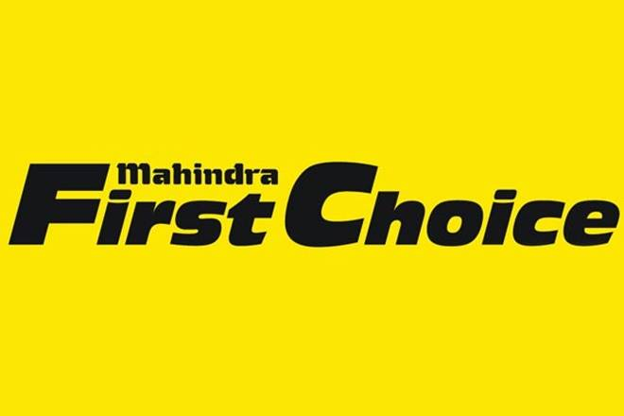
Geolocation Based Customer Analysis & Market Segmentation
Capstone Project
Project By
Aniket Mokashi
Roshankumar Bisoi

Slide 2
Problem Statement
Geolocation Based Customer Analysis
Identifying the ownership pattern of Cars throughout the country as well as information regarding the spending pattern.
Market Segmentation
Type of customers according to there spending, Service Time, Order Type, and other factors.

Slide 3
Data
We have 4 different dataset available are given below.
Customer Data : 555338 rows , 9 columns
Invoice Data : 492314 rows, 59 columns
Plant Data : 438 rows, 13 columns
JTD Data : 5619484 rows, 10 columns

Slide 4
Customer Data
Columns Deleted :- Marital Status, Occupation, Date of Birth, Death Date, Business Partner.
Columns filled for there missing values.
Columns Filled | Method
Partner Type | Mode
Data Origin | Mode
Title | Mode

Slide 5
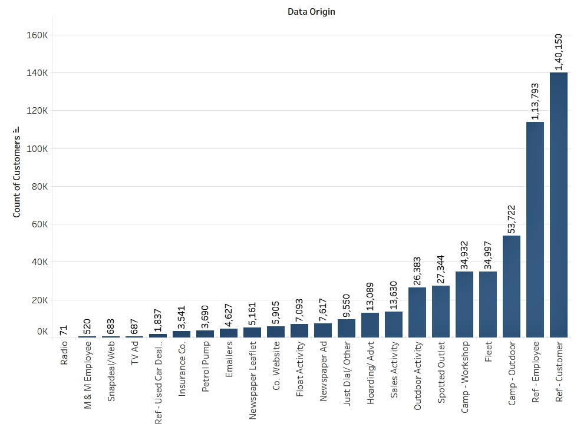
Customer Data : Insight
Column : Data Origin
Around 48% of the customer are from Reference of Customer (i.e. Z005) and Employee (i.e. Z006)
More than 15% of the customer are generated from Camps Such as Outdoor ( i.e. Z001) and Workshop
( i.e. Z002)

Slide 6
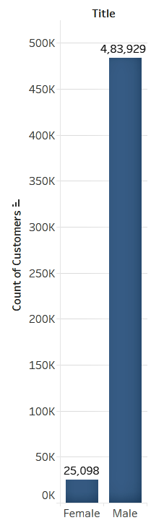
Customer Data : Insight
Column : Title
Not more than 5% of customers are Females.

Slide 7
Invoice Data
Columns Deleted :- All CGST, IGST, SGST/UGST, Total GST (i.e. around 16 columns) along with Amount Rcvd From Insurance Co, Amount Rcvd From Customer, Outstanding Amount, Recovrbl Exp, TDS Amount, Gate Pass Date, Insurance Company, Expiry Date, Policy no., Service Advisor Name, Cash/Cashless Type, Claim No., ODN No., Technician Name, Total Value, Area/Locality.
Columns filled for there missing values.
Columns Filled | Method
Customer Type | Mode
CITY | Mode
Model | Mode

Slide 8
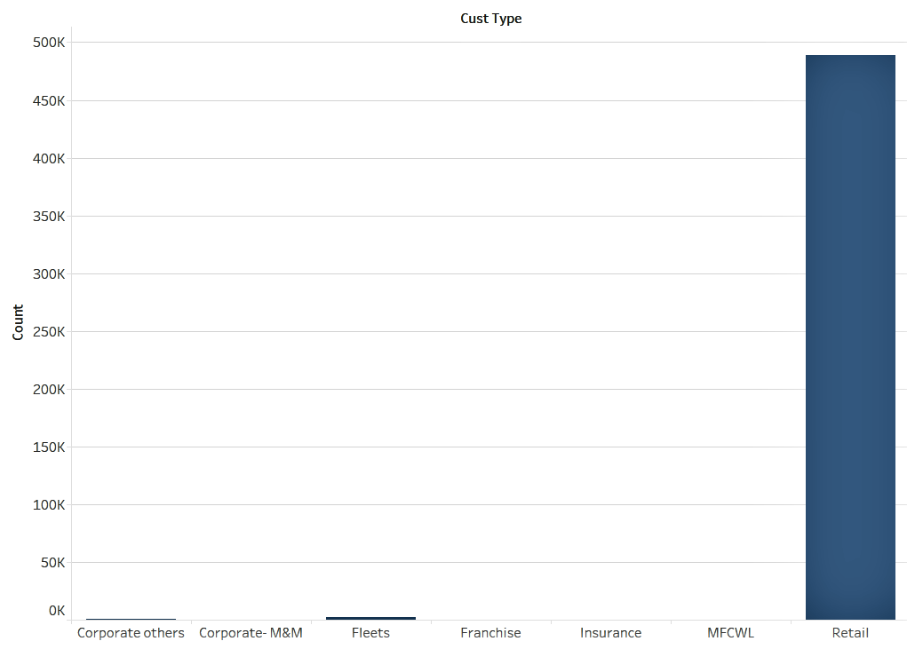
Invoice Data : Insight
Column : Customer Type
99% of the customer are Retail Type Customer and very few of them are from other Types.

Slide 9
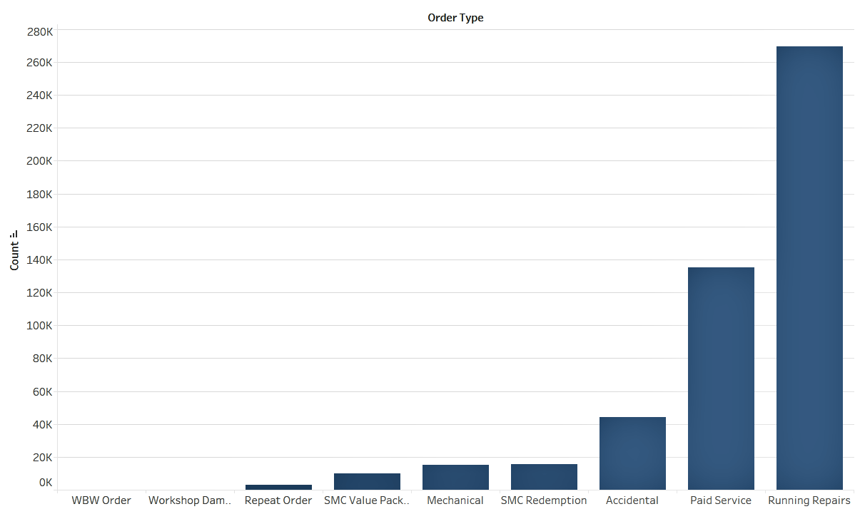
Invoice Data : Insight
Column : Order Type
Most of the Order Type are Paid Service and Running Repairs.
More than 90% of the Order Type comes under Paid Service (41%), Running Repairs (37%)and Accidental (15%).

Slide 10
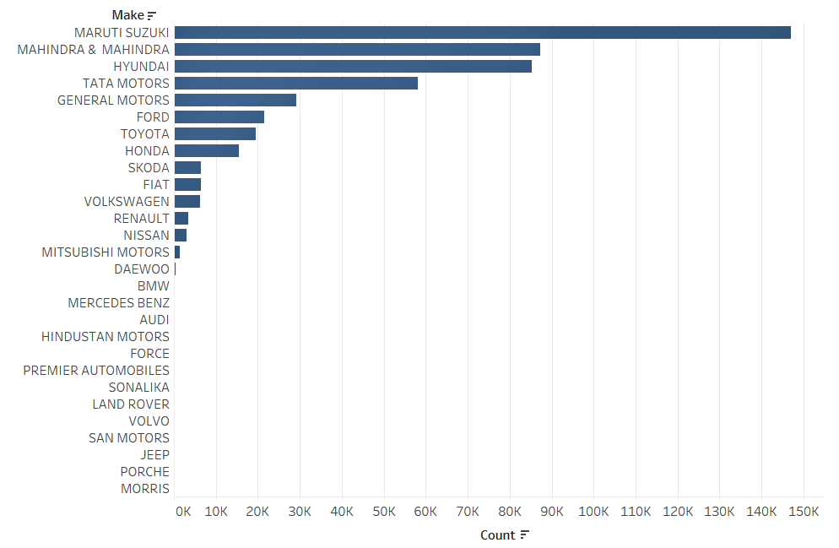
Invoice Data : Insight
Column : Make
Around 64% of the cars are of Indian Make such as Maruti Suzuki at the top followed by Mahindra & Mahindra and Tata Motors.
Whereas other than Indian make Hyundai, General Motors, Ford, Toyota Honda are also very frequent.

Slide 11
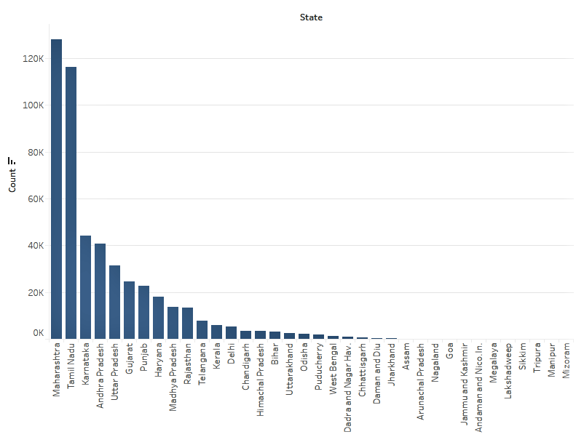
Invoice Data : Insight
Column : State
Around 39% of the customer are from Maharashtra (26%) and Tamil Nadu (23%).
The other states with the highest number of customers are Karnataka followed by Andhra Pradesh, Uttar Pradesh, Gujarat, Punjab, Haryana, Madhya Pradesh,and Rajasthan.

Slide 12
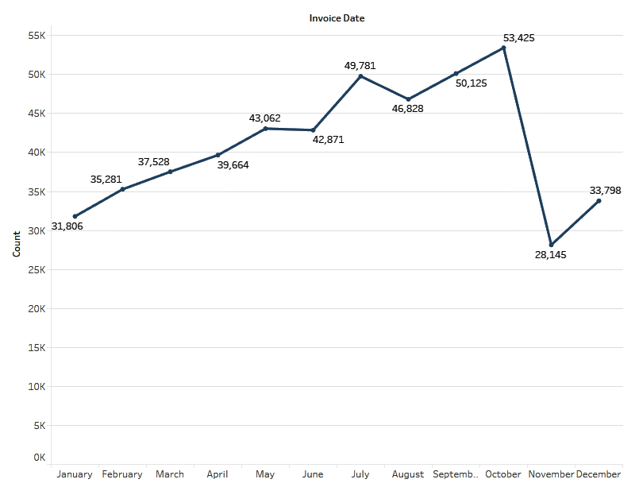
Invoice Data : Insight
Counts of Invoice has been started decreasing after October in every year.
It regains its pace at the end of the year.

Slide 13
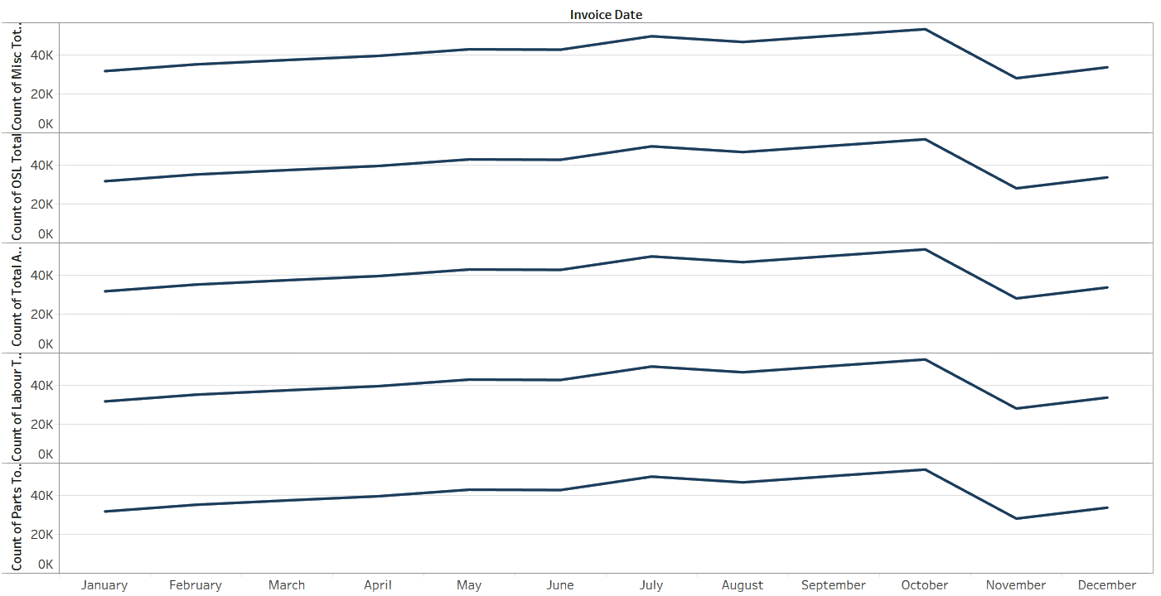
Invoice Data : Insight
The previous pattern can be seen with other numerical variables in the same manner.

Slide 14
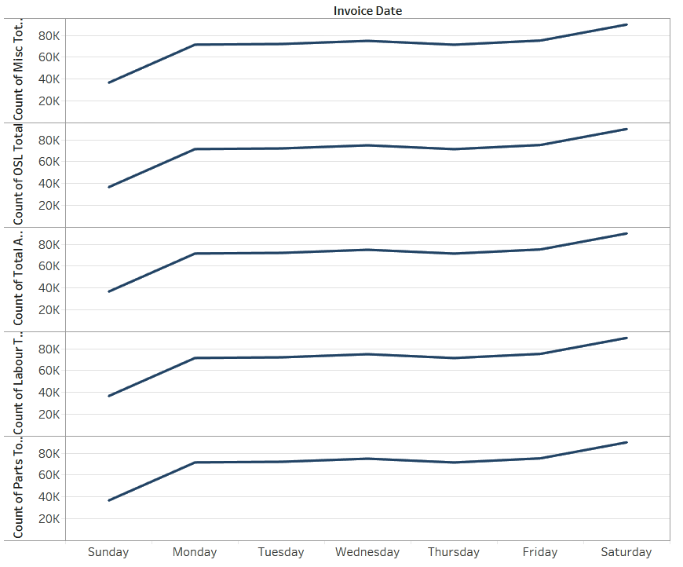
Invoice Data : Insight
We can also see repeated patterns in the days of the week.
Sunday is the lowest customer day while Saturday is the opposite.

Slide 15
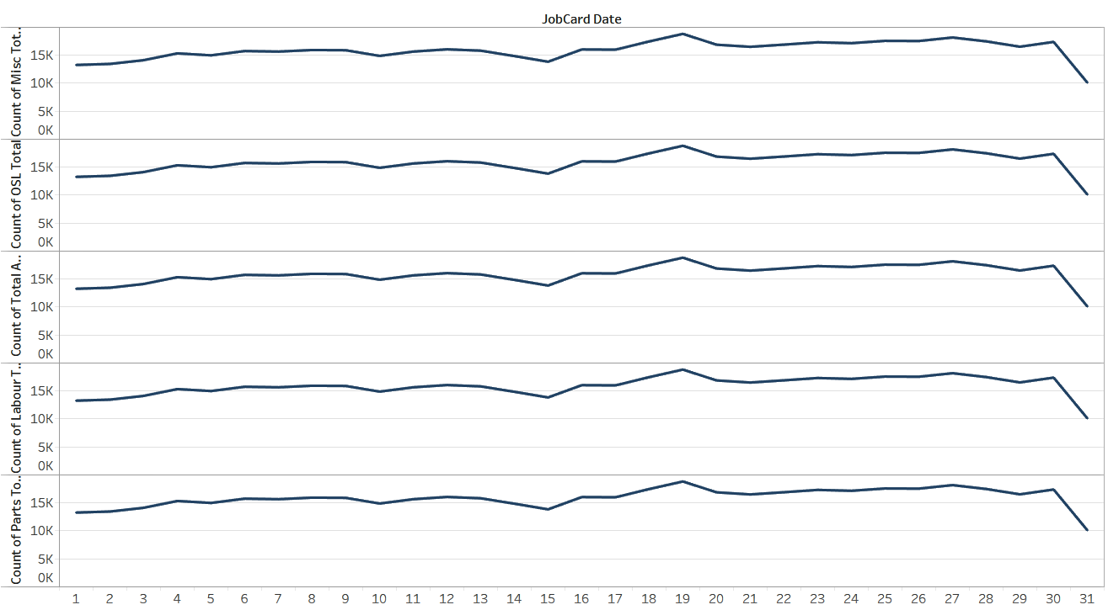
Invoice Data : Insight
Column :
The pattern can also be recognized in Days of Month chart.
Most sales are in the middle of the months.

Slide 16
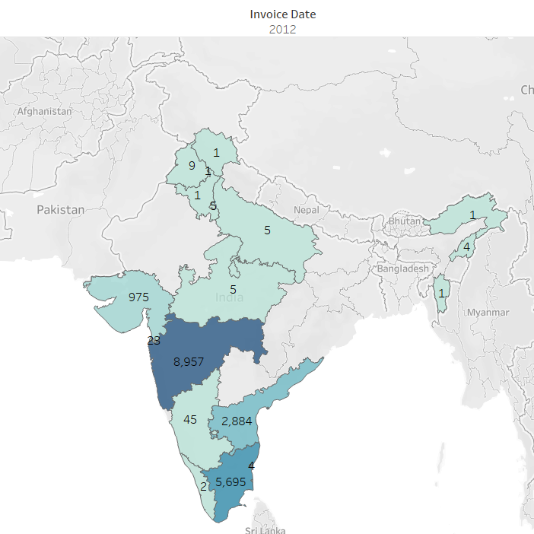
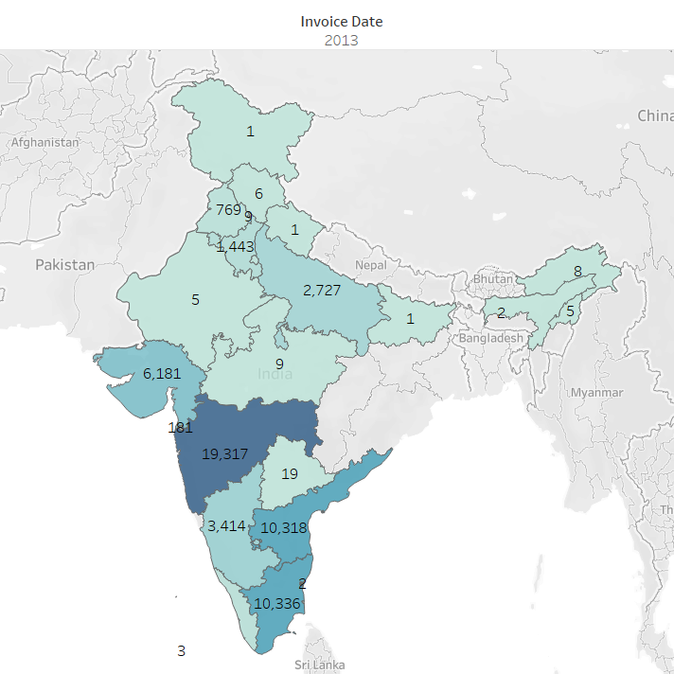
Counts of Customers in Year 2012 & 2013

Slide 17
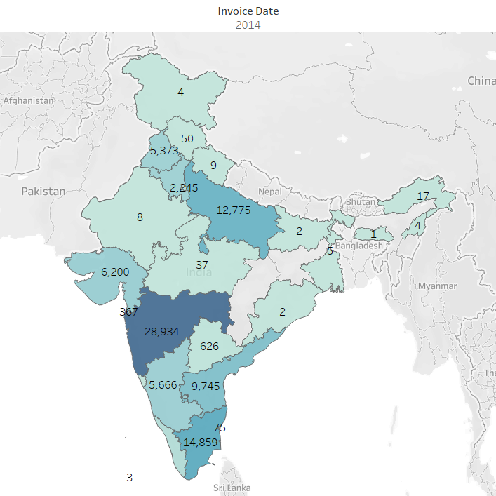
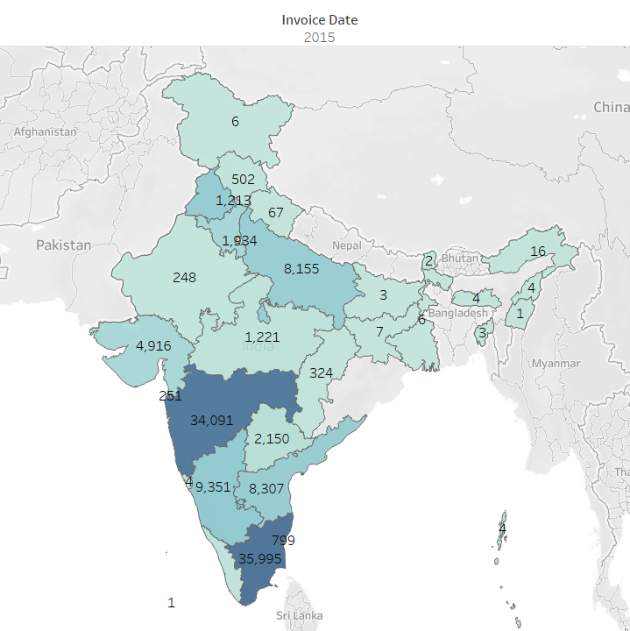
Counts of Customers in Year 2014 & 2015

Slide 18
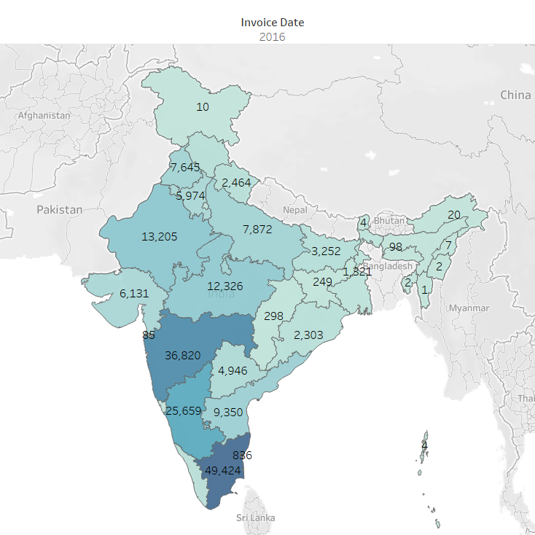
Counts of Customers in Year 2016
As we have seen Maharashtra is at the top in the number of services in the years 2012-14 consecutively.
But it’s changing after that and Tamil Naidu is at Top in the years 2015 and 2016.

Slide 19
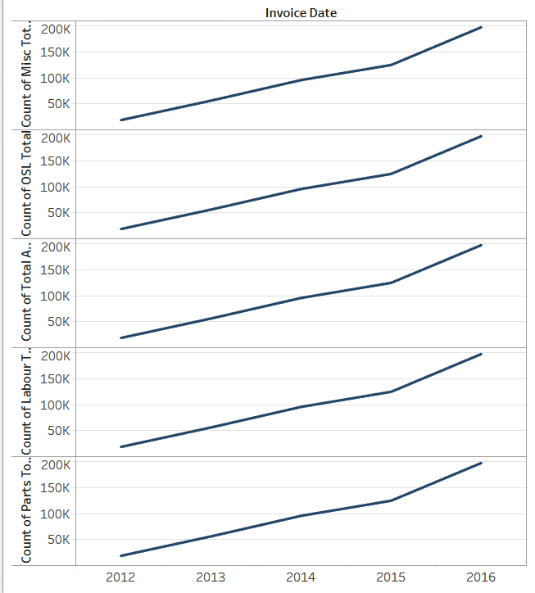
Invoice Data : Insight
The same pattern can be seen over the years in many numerical variables as well as counts.
Sales have been increasing with years of services.

Slide 20
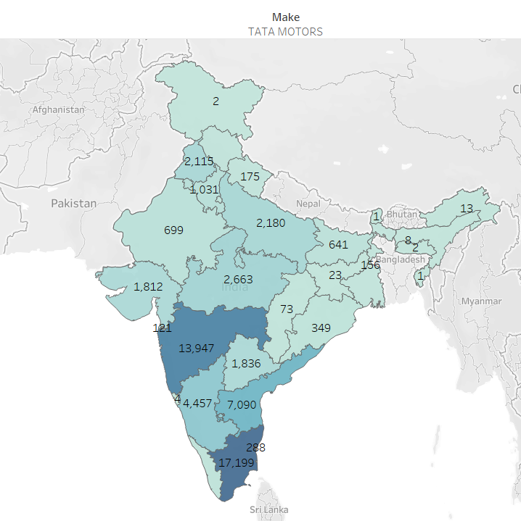
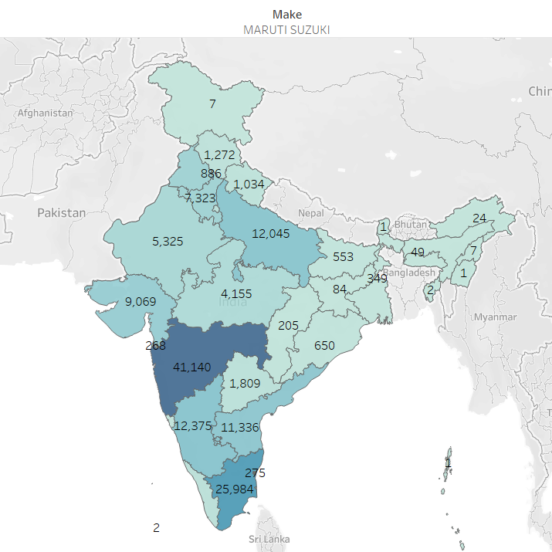
Counts of Customers for Indian Make Cars
TATA Motors & Maruti Suzuki

Slide 21
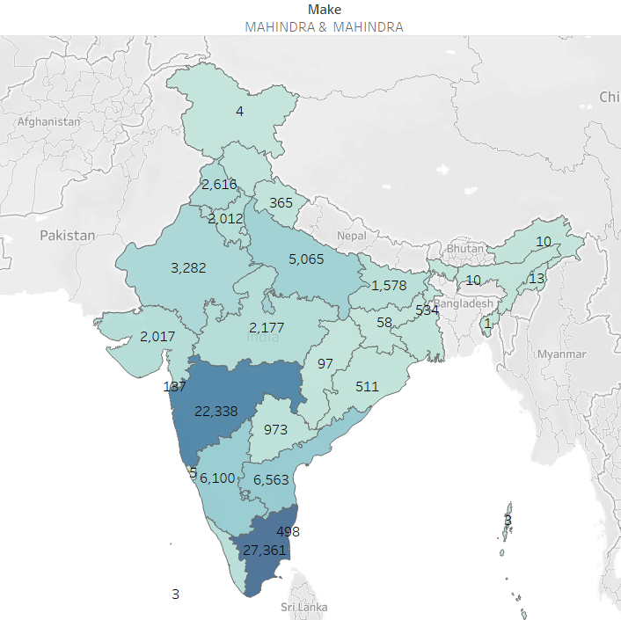
Counts of Customers for Indian Make Cars
Mahindra & Mahindra
Indian Make Cars such as Tata Motors, Mahindra & Mahindra, and Maruti Suzuki, which consist of 64% total customers for MFCS has traced all over India.

Slide 22
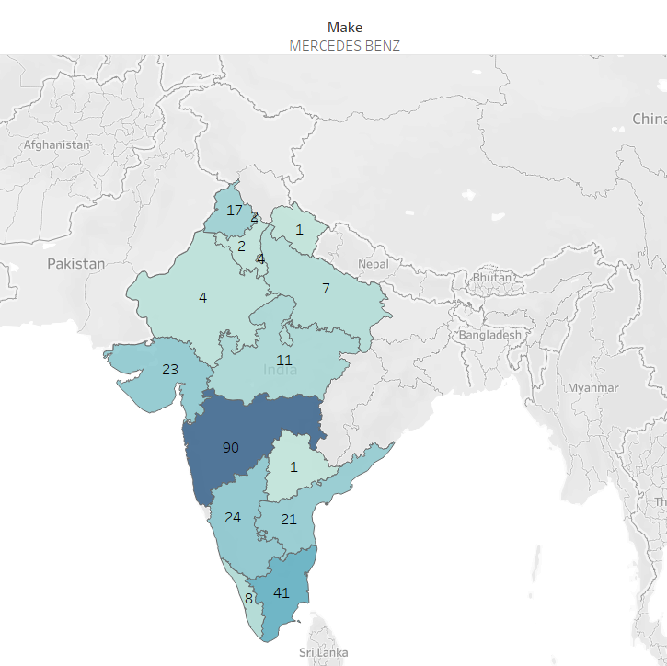
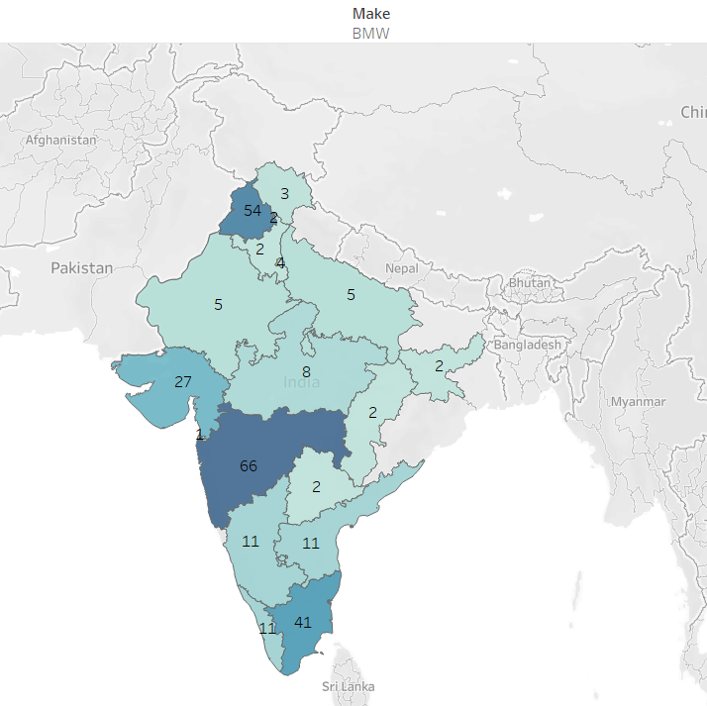
Counts of Customers for Luxury Cars Category
Mercedes Benz & BMW

Slide 23
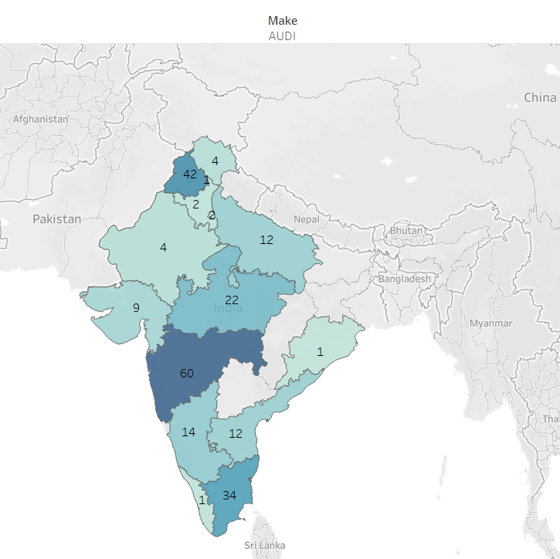
Counts of Customers for Luxury Cars Category
AUDI
Luxury car brands such as Audi, BMW, and Mercedes Benz have almost no customer for MFCS in the North-Eastern Regions of India.

Slide 24
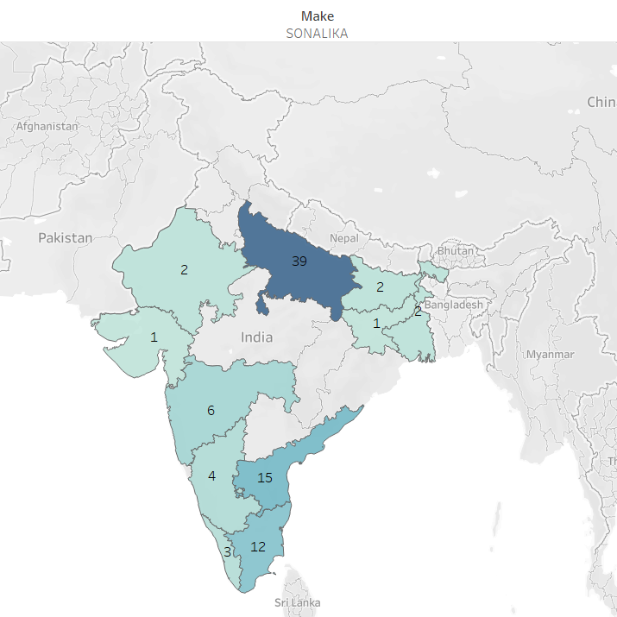
Counts of Customers in Tractors
SONALIKA
Tractor making companies such as SONALIKA have some different patterns compare to other regular cars.
Most tractor services have been done from Uttar Pradesh followed by Andhra Pradesh and Tamil Nadu

Slide 25
Plant Data
Columns Deleted :- Vendor number plant, Valuation Area, Factory calendar, Name 2, House number and street, PO Box, Customer no. – plant, Name1.
Columns Sales organization’s NaN values are filled with Mode method.

Slide 26
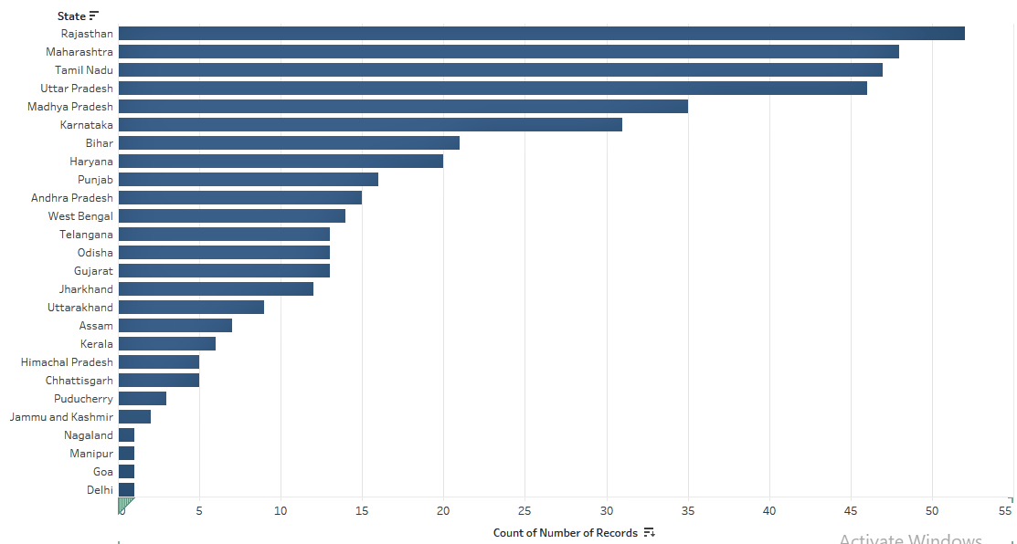
Plants Data : Insight
Column : States
Most Number of plants is in Rajasthan followed by Maharashtra, Tamil Naidu, Uttar Pradesh, Karnataka.
No. of Plant can also be a factor of most customers in Maharashtra and Tamil Nadu, But not in Rajasthan and Uttar Pradesh.

Slide 27
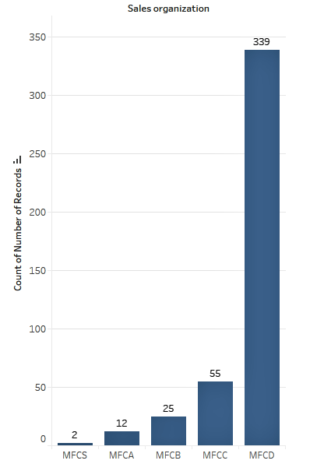
Invoice Data : Insight
Column : Sales Organization
Most of the Plants are in the Category of MFCD Sales Organization

Slide 28
JTD Data
Column Deleted :- Labour Value Number, Unnamed: 0.
Columns such as Material, Description and Target Quantity UoM have common rows filled with NaN values which were not more than 1% of total records dropped (rows).

Slide 29
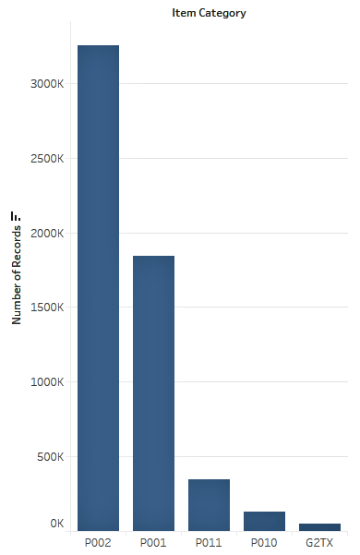
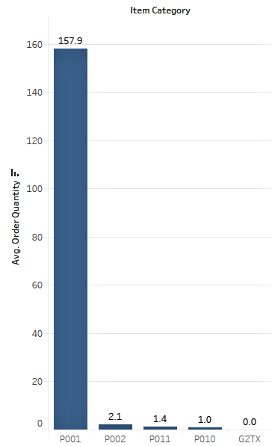
JTD Data : Insight
Column : Item Category
More than 90% of the Items used are from Category P002 (58%) and P001(35%).
But Average Order Quantity is very High For POO1.

Slide 30
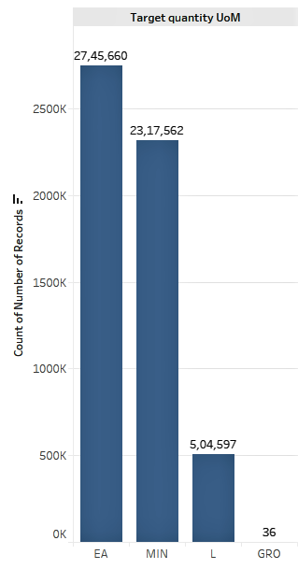
JTD Data : Insight
Column : Target Quantity UoM
Most of Target Quantity UoM falls under EA and MIN category.

Slide 31
Feature Engineering
Created a new column Service Time Category by taking the difference between Job Date Time and Invoice Date Time.
Service Time Category has classified into 5 categories.
Super Slow : More than 84 hrs
Slow : 61 – 84 hrs
Mid : 36 – 61 hrs
Fast : 13 – 36 hrs
Super Fast : Less than 13 hrs.

Slide 32
Feature Engineering
MERGING DATASETS
Customer Data and Invoice Data merged on Customer No.
Invoice_Customer Data merged with Plant Data on Plant Column.
Invoice_Customer_Plant merged with JTD Data where left on is Job Card No and right on is DBM Order.

Slide 33
Feature Engineering
DELETING COLUMNS FORS CLUSTERING PURPOSE.
Unique ID columns : Customer No., DBM Order, Plant Name1, User ID.
Date Time Columns : Invoice Date, Invoice Time, JobCard Date, JobCard Time.
Categorical Columns : State, City, Pin Code & Title.
Numerical Columns : Misc Total, OSL Total.

Slide 34
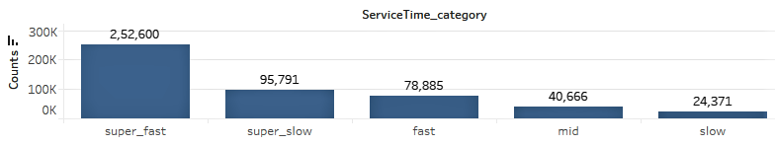
Service Time Category : Insight
Most of Services are Super_fast followed by Super_slow and fast.

Slide 35
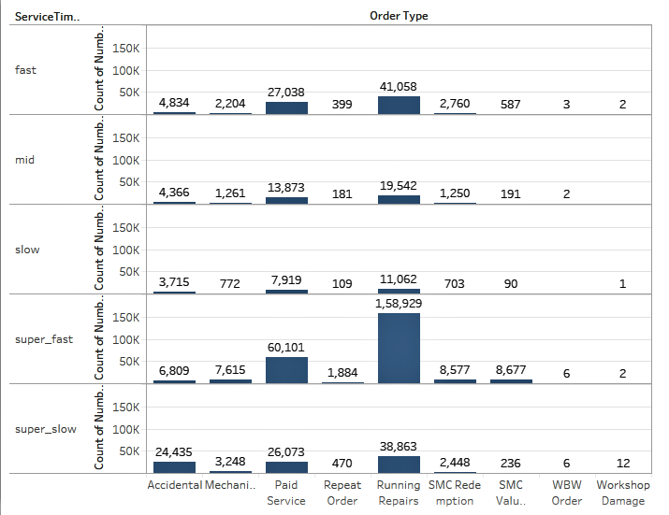
Service Time Category : Insight
As you can see the super_slow category does have the highest number of Accidental Order Type Compare to other Service Time Categories.
Above might be the reason for super_slow of becoming the second most frequent Service Time Category.

Slide 36
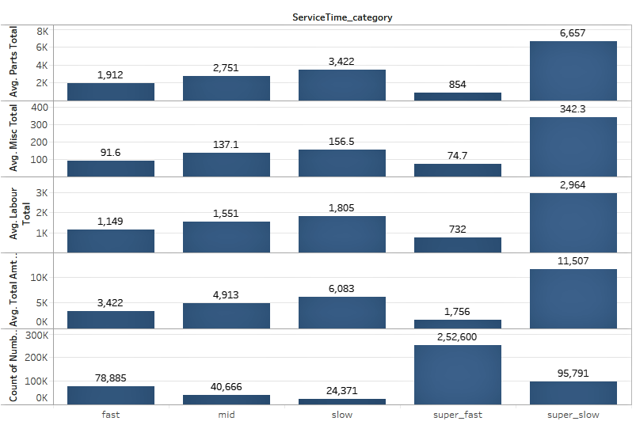
Service Time Category : Insight
Super_Fast is the most frequent Service Time Category.
Above is reasonable since it can be seen that Average Labour Total, Average Total Amt Wtd Tax., Average Misc Total and Average Parts Total is lowest compare to other Service Time Category.

Slide 37
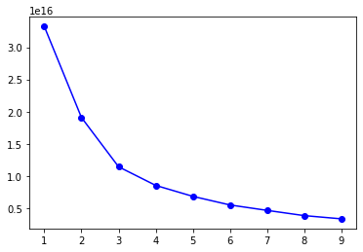
Clustering
Label Encoding is done on Categorical columns.
K-Mean Algorithm used for Clustering.
Number of Clusters selected using the Elbow Method.
After k=4, The Cost function drops drastically so we find it relevant to take it as Number of Clusters.

Slide 38
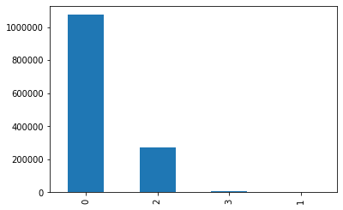
Clustering
After applying K-means Algorithm for 4 Clusters, we have found that most customers fall under cluster 0 followed by cluster 2.
Cluster 1 has the lowest number of Customers.
Clusters

Slide 39
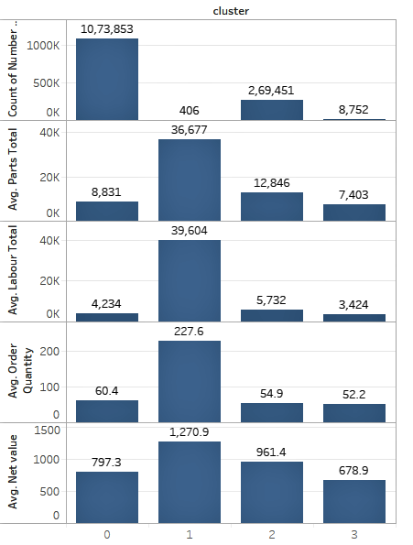
Cluster Identification
Cluster 1 which consists of the lowest number of customers has the highest average value for variables such as Net Value, Parts Total, Order Quantity, Labour Total.

Slide 40
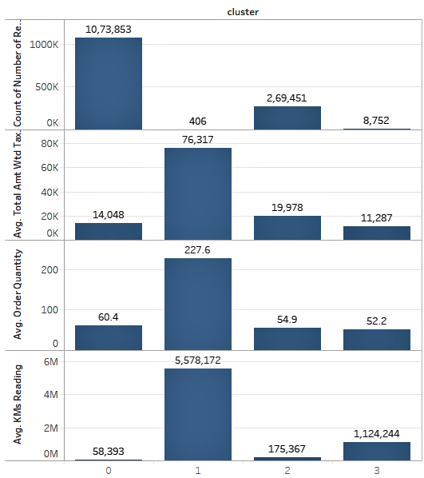
Cluster Identification
As well as Cluster 1 has the highest average value for variables such as Order Quantity, KMs Reading,
Total Amt Wtd Tax.

Slide 41
Prescription
Provide or increase referral Bonus for Consumer and Employee, Since they generate the most number of customers.
Do more Camps (Outdoor or Workshop) as it also generates a good amount of customers.
Provide different offers according to the geographical location of the plant. Example : Provide Discount Offers for Tractor Services in Agricultural dependent states.
Use Inventory ( i.e. Order Type and Item Category) more efficiently according to the Data, Trends, Demands, Geographical Location so that we can make Service Time more faster.
Improve the number of plants in regions we required such as Northern & Eastern Regions.
Reduce or Relocate the plant so it can effectively increase the number of customers.

